Slide 1
Uncontrolled copy not subject to amendment
Principles of Flight
Learning Outcome 3
Know the principles of flight and control for gliders
Identify forces acting on a glider in flight
Revision 2.00

Slide 2
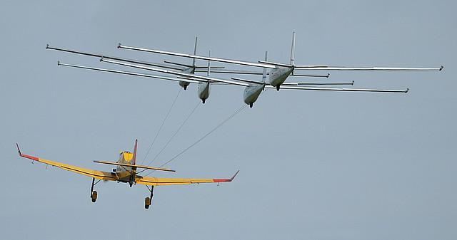
Principles of Flight
Revision

Slide 3
Questions for you …..

Slide 4
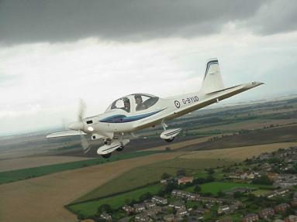
What happens to lift when a wing is stalled?
a. Lift increases as the angle of attack decreases
b. Lift decreases as the angle of attack increases
c. Lift is greatly reduced
d. Lift remains unchanged

Slide 5
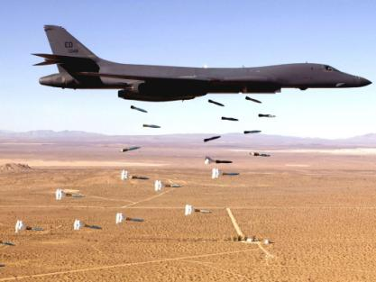
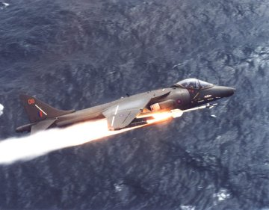
The critical angle of attack is generally about ....
a. 5º
b. 15º
c. 25º
d. 35º

Slide 6
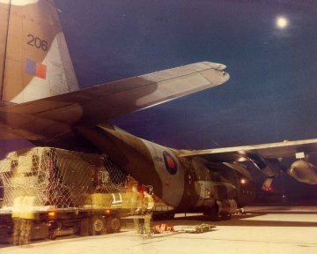
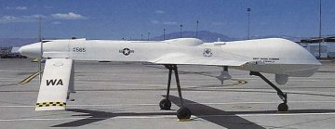
3. Which of the following will NOT reduce stalling speed?
a. Extra weight
b. Larger wing area
c. Flaps lowered
d. Flaps raised

Slide 7
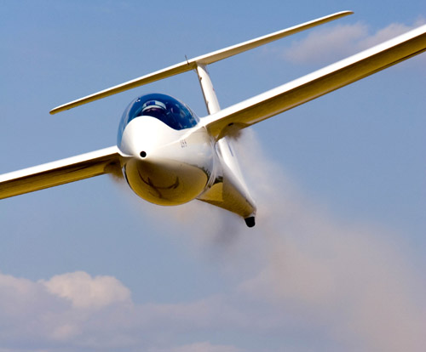
Gliding

Slide 8
Gliding
Objectives:
List and describe the forces acting on a glider during balanced flight
State the effect of wind on the distance travelled over the ground
Explain the effects of airbrakes on glide performance
Understand the gliding angle (angle of attack)

Slide 9
Are these forces in balance for straight and level flight?
What are the Forces acting on a Powered Aircraft?
Lift
Drag
Thrust
Weight
Notes:
What forces are present in straight and level flight?
Where do these forces act through? Show Centre of Gravity (CG).
Could show CG using an odd shaped object.

Slide 10
What would happen if we had NO thrust?
Lift
Drag
Thrust
Weight
What do we need to do to overcome drag?
Notes:
What forces are present in straight and level flight?
Where do these forces act through? Show Centre of Gravity (CG).
Could show CG using an odd shaped object.

Slide 11
Lift
Drag
Weight
Notes:
What forces are present in straight and level flight?
Where do these forces act through? Show Centre of Gravity (CG).
Could show CG using an odd shaped object.

Slide 12
Lift
Drag
Weight
Notes:
What forces are present in straight and level flight?
Where do these forces act through? Show Centre of Gravity (CG).
Could show CG using an odd shaped object.

Slide 13
Gliding speed
The car can coast down the hill with no engine
How?
GRAVITY
Can we use gravity to fly a glider?

Slide 14
Gliding speed
A glider uses gravity to descend
The airflow over the wing
produces lift
How do we control the speed?

Slide 15
Lift
Speed
If the nose is raised, what will happen?
Lift and speed reduce
The rate of descent also reduces

Slide 16
Lift
Speed
If the nose is lowered, what will happen?
Lift and speed increase
The rate of descent also increases

Slide 17
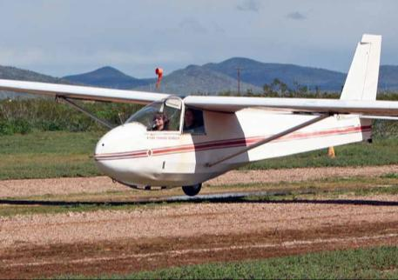
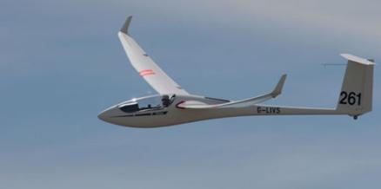
Remember:
If you fly too slowly lift will be lost and the glider will stall
If you fly too quickly the rate of descent will be high

Slide 18
How far will a glider travel?
The flatter the gliding angle, the further the distance over the ground
The steeper the gliding angle, the shorter the distance over the ground
What is the BEST angle to fly at?

Slide 19
Lift/Drag ratio
C_{L}
C_{D}
α
0°
α

Slide 20
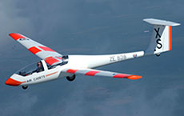
The Pilot’s Notes will give information on gliding speeds
For example:
A Viking glider’s angle is about 1 in 35
Therefore, from a height of 3,280 ft (1 kilometre), in still air, it will travel about 35 kilometres

Slide 21
The effect of wind
What will happen when flying at the same airspeed and angle of attack?

Slide 22
What will happen when flying at the same airspeed and angle of attack?
Still air
Headwind
Tailwind

Slide 23
The effect of the airbrake
When the airbrake is opened, what happens to the drag?
The drag increases
What must be done to maintain airspeed?
Lower the nose

Slide 24
Airbrake in
Airbrake out
= steeper descent
+ shorter ground distance

Slide 25
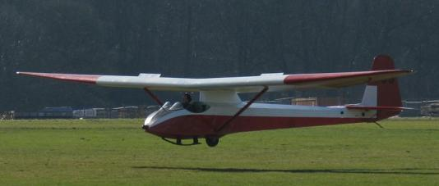
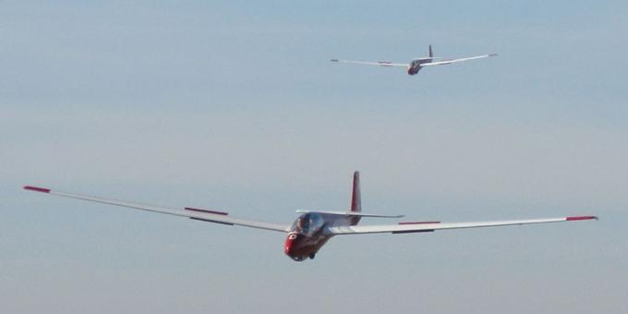
Airbrakes

Slide 26
Any questions?

Slide 27
Questions for you …..

Slide 28
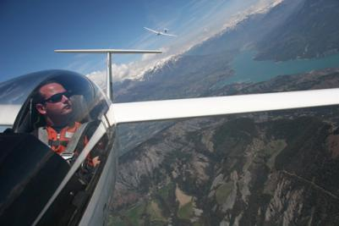
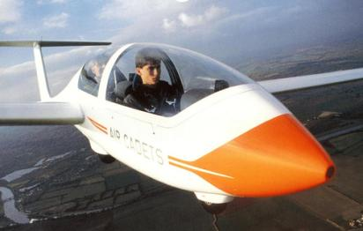
Name the forces acting on a glider in normal flight
a. Force, weight and lift
b. Drag, weight and thrust
c. Drag, weight and lift
d. Drag, thrust and lift

Slide 29
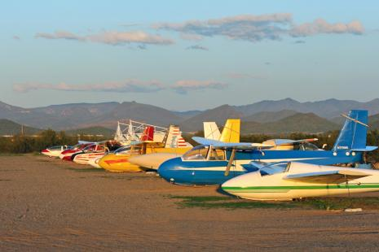
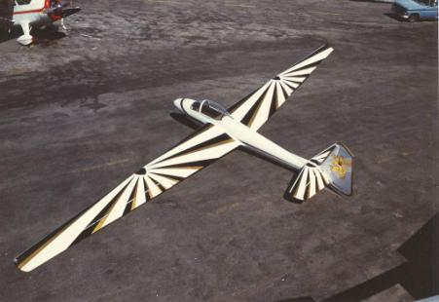
How does a glider pilot Increase airspeed?
a. Operate the airbrakes
b. Lower the nose by pushing the stick forward
    Raise the nose by pulling the stick back
d. Lower the nose by pulling the stick back

Slide 30
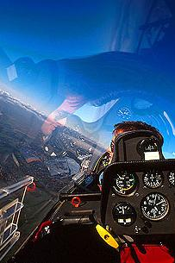
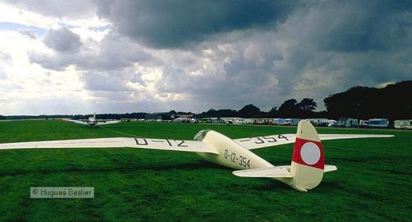
3. A Viking glider descends from 1640 ft (0.5 km). How far over the ground does it travel (in still air)?
a. 17.5 km
b. 35 km
c. 70 km
d. 8.75 km

Slide 31
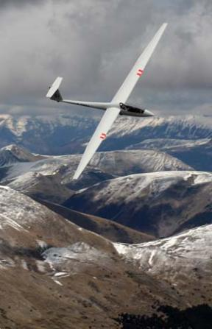
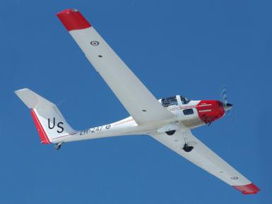
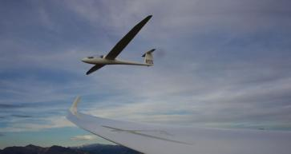
4. When flying into a headwind, the distance covered over the ground will .....
a. Be the same
b. Decrease
c. Increase
d. Take you to Burger King

